Slide 1
Inverse Discrete Fourier Transform (IDFT)

Slide 2
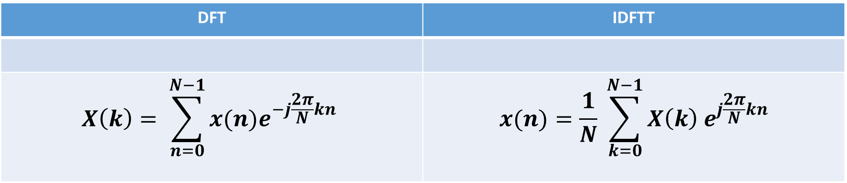
DFT | IDFTT
$$X\left(k\right)= \sum_{n=0}^{N−1}{x(n)e^{−j\frac{2π}{N}kn}}$$ | $$x(n)=\frac{1}{N} \sum_{k=0}^{N−1}{X\left(k\right) e^{j\frac{2π}{N}kn}}$$

Slide 3
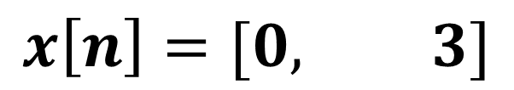
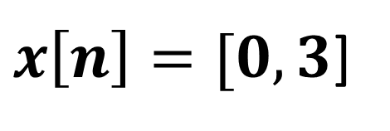

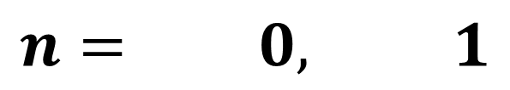
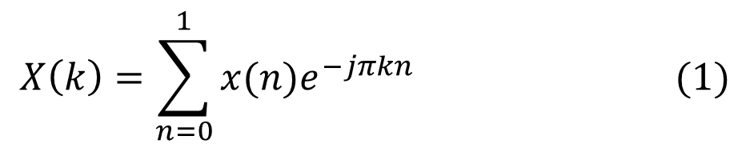
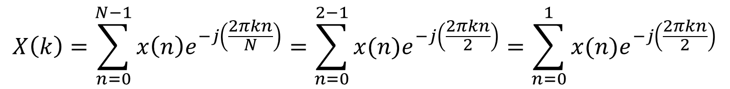
Example: Calculate the 2-point Discrete Fourier Transform (DFT) of given sequence $x\left[n\right]=[0,3]$
$x\left[n\right]=[0,3$]
SOLUTION
$$x\left[n\right]=[0, 3]$$
x(0) = 0
x(1) = 3
$$n= 0, 1$$
STEP:-1: Check Length of Sequence is = N = 2, then value of k is also two, k = 0, 1
$$X\left(k\right)=\sum_{n=0}^{N−1}{x\left(n\right)e^{−j\left(\frac{2πkn}{N}\right)}=\sum_{n=0}^{2−1}{x(n)e^{−j\left(\frac{2πkn}{2}\right)}}=\sum_{n=0}^{1}{x(n)e^{−j\left(\frac{2πkn}{2}\right)}}}$$
$$X\left(k\right)=\sum_{n=0}^{1}{x(n)e^{−jπkn}} (1)$$

Slide 4

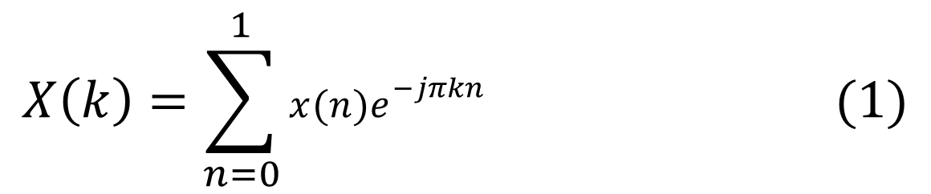
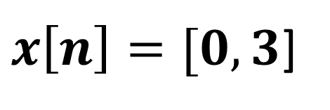
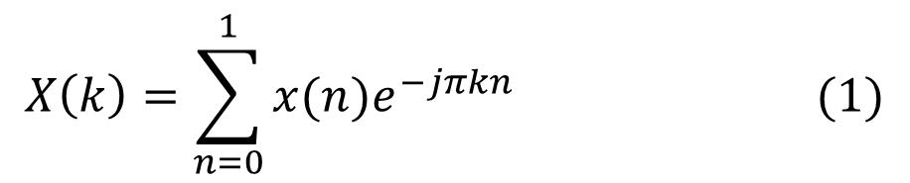
$x\left[n\right]=[0,3$]
STEP:-2: Put k = 0 in equation (1)
$$X\left(k\right)=\sum_{n=0}^{1}{x(n)e^{−jπkn}} (1)$$
x(0) = 0
x(1) = 3
$$X\left(0\right)=\sum_{n=0}^{1}{x(n)e^{−jπkn}}=\sum_{n=0}^{1}{x(n)e^{0}}=\sum_{n=0}^{1}{x\left(n\right)∗1=\sum_{n=0}^{1}{x\left(n\right)=x\left(0\right)+x\left(1\right)=0 +3=3}}$$
STEP:-2: Put k = 1 in equation (1)
$$X\left(k\right)=\sum_{n=0}^{1}{x(n)e^{−jπkn}} (1)$$
$$X\left(1\right)=\sum_{n=0}^{1}{x(n)e^{−jπkn}}=\sum_{n=0}^{1}{x(n)e^{−jπ∗1∗n}}=\sum_{n=0}^{1}{x(n)e^{−jπn}}$$
$$X\left(1\right)=x\left(0\right)e^{0}+x\left(1\right)e^{−jπ∗1}= x\left(0\right)∗1+x\left(1\right)e^{−jπ}$$

Slide 5
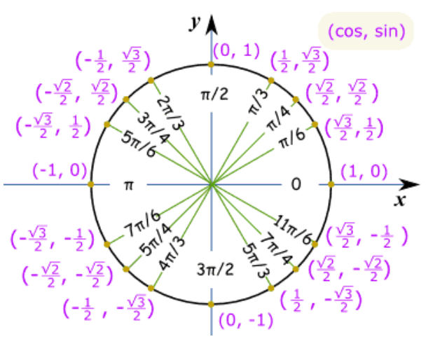
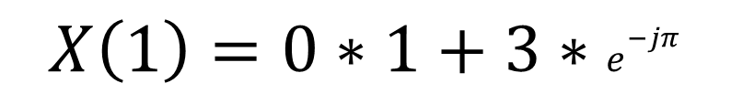
$x\left[n\right]=[0,3$]
$$X\left(1\right)=x\left(0\right)e^{0}+x\left(1\right)e^{−jπ∗1}= x\left(0\right)∗1+x\left(1\right)e^{−jπ}$$
x(0) = 0
x(1) = 3
$$X\left(1\right)=0∗1+3∗e^{−jπ}$$
$$X\left(1\right)=3∗e^{−jπ}=3∗e^{−j\left(π\right)}=3\left(−1+j0\right)=−3$$
$$X\left[k\right]=\left[X\left(0\right), X\left(1\right)\right]=\left[3,−3\right] Answer$$

Slide 6
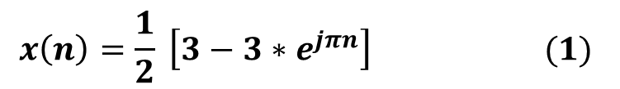
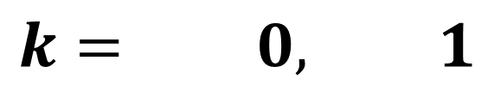

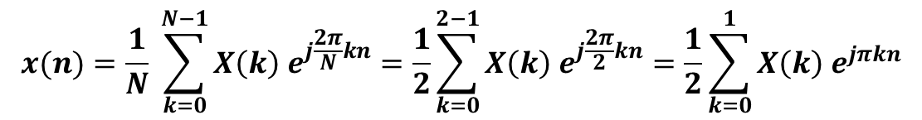
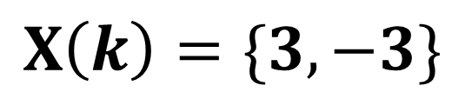
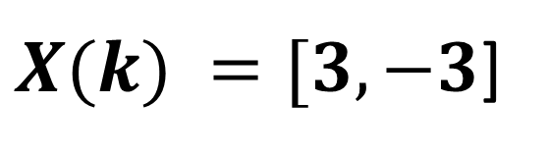
Example: Calculate the 2-point Inverse Discrete Fourier Transform (IDFT) of given sequence $X\left(k\right)=\{3,−3\}$
$X(k) =[3,−3$]
SOLUTION
$$X\left(k\right)=\{3,−3\}$$
X(0) = 3
X(1) = -3
$$k= 0, 1$$
STEP:-1: Check Length of Sequence is = N = 2, then value of n is also two, n = 0, 1
$$x(n)=\frac{1}{N} \sum_{k=0}^{N−1}{X\left(k\right) e^{j\frac{2π}{N}kn}=\frac{1}{2}\sum_{k=0}^{2−1}{X\left(k\right) e^{j\frac{2π}{2}kn}=\frac{1}{2}\sum_{k=0}^{1}{X\left(k\right) e^{jπkn}}}}$$
$$x\left(n\right)=\frac{1}{2}\sum_{k=0}^{1}{X\left(k\right) e^{jπkn}}=\frac{1}{2} \left[X\left(0\right)e^{0}+X\left(1\right)e^{jπ∗1∗n}\right]=\frac{1}{2} \left[3∗1+\left(−3\right)∗e^{jπn}\right]=\frac{1}{2} \left[3−3∗e^{jπn}\right]$$
$$x\left(n\right)=\frac{1}{2} \left[3−3∗e^{jπn}\right] (1)$$

Slide 7
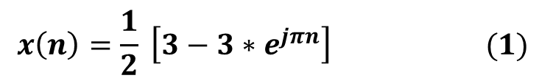
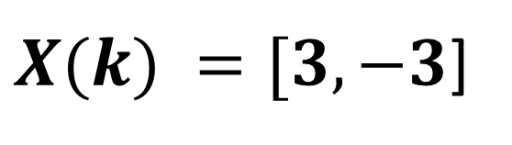
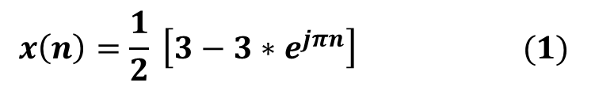
$X(k) =[3,−3$]
STEP:-2: Put n = 0 in equation (1)
$$x\left(n\right)=\frac{1}{2} \left[3−3∗e^{jπn}\right] (1)$$
X(0) = 3
X(1) = -3
$$x\left(0\right)=\frac{1}{2} \left[3−3∗e^{jπ∗0}\right]=\frac{1}{2}\left[3−3∗e^{0}\right]=\frac{1}{2}\left[3−3\right]=\frac{1}{2}\left[0\right]=0$$
STEP:-2: Put n = 1 in equation (1)
$$x\left(n\right)=\frac{1}{2} \left[3−3∗e^{jπn}\right] (1)$$
$$x\left(1\right)=\frac{1}{2} \left[3−3∗e^{jπ∗1}\right]=\frac{1}{2} \left[3−3∗e^{jπ}\right]=\frac{1}{2} \left[3−3∗(−1+jo) \right]=\frac{1}{2} \left[3+3\right]=3$$
$$x\left(n\right)=\left[x\left(0\right), x\left(1\right)\right]=\left[0,3\right] Answer$$

Slide 8
Example: Calculate the 2-point Inverse Discrete Fourier Transform (IDFT) of given sequence $X\left(k\right)=\{3,−3\}$
$X(k) =[3,−3$]
SOLUTION
$$X\left(k\right)=\{3,−3\}$$
X(0) = 3
X(1) = -3
$$k= 0, 1$$
STEP:-1: Check Length of Sequence is = N = 2, then value of n is also two, n = 0, 1
$$x(n)=\frac{1}{N} \sum_{k=0}^{N−1}{X\left(k\right) e^{j\frac{2π}{N}kn}=\frac{1}{2}\sum_{k=0}^{2−1}{X\left(k\right) e^{j\frac{2π}{2}kn}=\frac{1}{2}\sum_{k=0}^{1}{X\left(k\right) e^{jπkn}}}}$$
$$x\left(n\right)=\frac{1}{2}\sum_{k=0}^{1}{X\left(k\right) e^{jπkn}}=\frac{1}{2} \left[X\left(0\right)e^{0}+X\left(1\right)e^{jπ∗1∗n}\right]=\frac{1}{2} \left[3∗1+\left(−3\right)∗e^{jπn}\right]=\frac{1}{2} \left[3−3∗e^{jπn}\right]$$
$$x\left(n\right)=\frac{1}{2} \left[3−3∗e^{jπn}\right] (1)$$

Slide 9
$X(k) =[3,−3$]
STEP:-2: Put n = 0 in equation (1)
$$x\left(n\right)=\frac{1}{2} \left[3−3∗e^{jπn}\right] (1)$$
X(0) = 3
X(1) = -3
$$x\left(0\right)=\frac{1}{2} \left[3−3∗e^{jπ∗0}\right]=\frac{1}{2}\left[3−3∗e^{0}\right]=\frac{1}{2}\left[3−3\right]=\frac{1}{2}\left[0\right]=0$$
STEP:-2: Put n = 1 in equation (1)
$$x\left(n\right)=\frac{1}{2} \left[3−3∗e^{jπn}\right] (1)$$
$$x\left(1\right)=\frac{1}{2} \left[3−3∗e^{jπ∗1}\right]=\frac{1}{2} \left[3−3∗e^{jπ}\right]=\frac{1}{2} \left[3−3∗(−1+jo) \right]=\frac{1}{2} \left[3+3\right]=3$$
$$x\left(n\right)=\left[x\left(0\right), x\left(1\right)\right]=\left[0,3\right] Answer$$

Slide 10

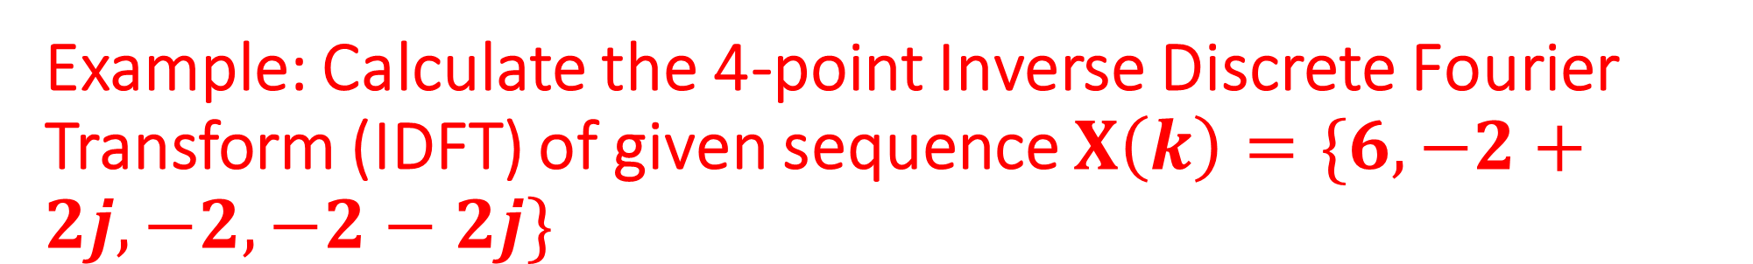
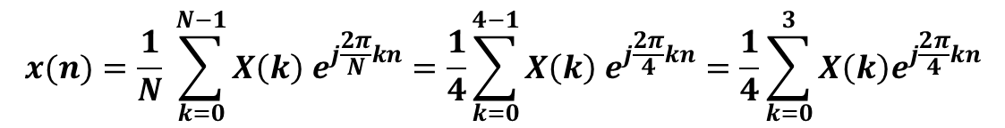
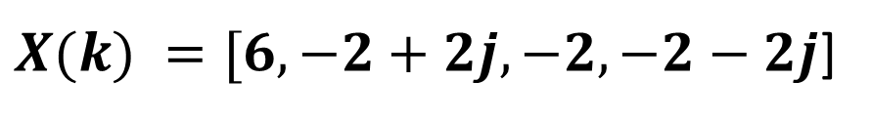
Example: Calculate the 4-point Inverse Discrete Fourier Transform (IDFT) of given sequence $X\left(k\right)=\{6, −2+2j, −2, −2−2j\}$
$X(k) =[6, −2+2j, −2, −2−2j$]
SOLUTION
$$X\left(k\right)=\{6, −2+2j, −2, −2−2j\}$$
X(0) = 6
X(3) = -2-2j
X(1) = -2+2j
X(2) = -2
$$k= 0, 1, 2, 3$$
STEP:-1: Check Length of Sequence is = N = 4, then value of n is also four, n = 0, 1,2,3
$$x(n)=\frac{1}{N} \sum_{k=0}^{N−1}{X\left(k\right) e^{j\frac{2π}{N}kn}=\frac{1}{4}\sum_{k=0}^{4−1}{X\left(k\right) e^{j\frac{2π}{4}kn}=\frac{1}{4}\sum_{k=0}^{3}{X\left(k\right)e^{j\frac{2π}{4}kn}}}}$$
$$x\left(n\right)=\frac{1}{4}\sum_{k=0}^{3}{X\left(k\right)e^{j\frac{2π}{4}kn}}=\frac{1}{4} \left[X\left(0\right)e^{0}+X\left(1\right)e^{j\frac{2π}{4}∗1∗n}+X\left(2\right)e^{j\frac{2π}{4}∗2∗n}+X\left(3\right)e^{j\frac{2π}{4}∗3∗n}\right]$$
$$x\left(n\right)=\frac{1}{4}\sum_{k=0}^{3}{X\left(k\right)e^{j\frac{2π}{4}kn}}=\frac{1}{4} \left[6+(−2+2j)e^{j\frac{2π}{4}∗1∗n}+(−2)e^{j\frac{2π}{4}∗2∗n}+(−2−2)e^{j\frac{2π}{4}∗3∗n}\right]$$

Slide 11
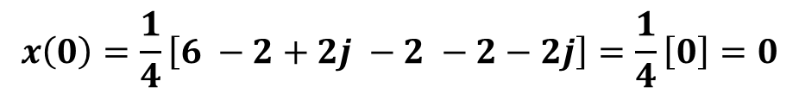
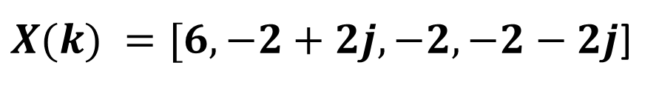
$$x\left(n\right)=\frac{1}{4} \left[(6) +(−2+2j)e^{j\frac{2π}{4}∗1∗n}+(−2)e^{j\frac{2π}{4}∗2∗n}+(−2−2j)e^{j\frac{2π}{4}∗3∗n}\right]$$
$$x\left(n\right)=\frac{1}{4} \left[(6) +(−2+2j)e^{j\frac{πn}{2}}+(−2)e^{jπn}+(−2−2j)e^{j\frac{3πn}{2}}\right] (1)$$
$X(k) =[6, −2+2j, −2, −2−2j$]
X(0) = 6
X(3) = -2-2j
X(1) = -2+2j
X(2) = -2
STEP:-2: Put n = 0 in equation (1)
$$x\left(0\right)=\frac{1}{4} \left[(6) +(−2+2j)e^{j\frac{π∗0}{2}}+(−2)e^{jπ∗0}+(−2−2j)e^{j\frac{3π∗0}{2}}\right]=\frac{1}{4}\left[6+\left(−2+2j\right)∗1+\left(−2\right)∗1+\left(−2−2j\right)∗1\right]$$
$$x\left(0\right)=\frac{1}{4}\left[6 −2+2j −2 −2−2j\right]=\frac{1}{4}\left[0\right]=0$$

Slide 12
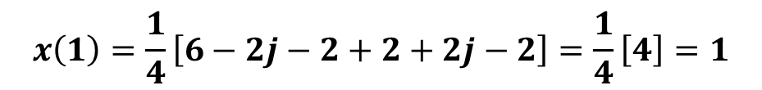
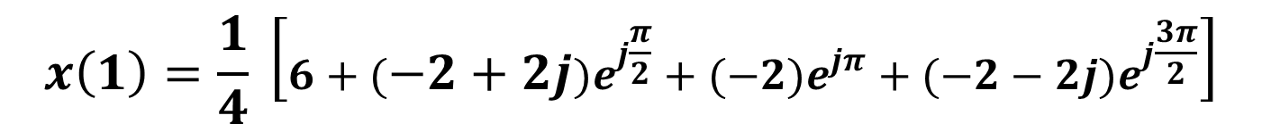
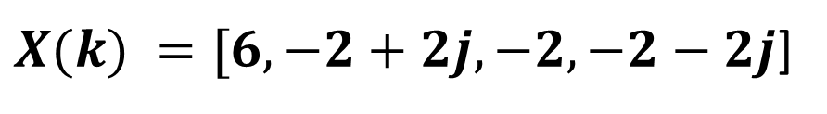
$$x\left(n\right)=\frac{1}{4} \left[(6) +(−2+2j)e^{j\frac{πn}{2}}+(−2)e^{jπn}+(−2−2j)e^{j\frac{3πn}{2}}\right] (1)$$
$X(k) =[6, −2+2j, −2, −2−2j$]
X(0) = 6
X(3) = -2-2j
X(1) = -2+2j
X(2) = -2
STEP:-2: Put n = 1 in equation (1)
$$x\left(1\right)=\frac{1}{4} \left[(6) +(−2+2j)e^{j\frac{π∗1}{2}}+(−2)e^{jπ∗1}+(−2−2j)e^{j\frac{3π∗1}{2}}\right]$$
$$x\left(1\right)=\frac{1}{4} \left[6+(−2+2j)e^{j\frac{π}{2}}+(−2)e^{jπ}+(−2−2j)e^{j\frac{3π}{2}}\right]$$
$$x\left(1\right)=\frac{1}{4}\left[6+\left( −2+2j\right)∗\left(j\right)+\left( −2 \right)∗\left(−1\right)+\left(−2−2j\right)∗(−j1)\right]$$
$$x\left(1\right)=\frac{1}{4}\left[6−2j−2+2+2j−2\right]=\frac{1}{4}\left[4\right]=1$$

Slide 13
$$x\left(n\right)=\frac{1}{4} \left[(6) +(−2+2j)e^{j\frac{πn}{2}}+(−2)e^{jπn}+(−2−2j)e^{j\frac{3πn}{2}}\right] (1)$$
$X(k) =[6, −2+2j, −2, −2−2j$]
X(0) = 6
X(3) = -2-2j
X(1) = -2+2j
X(2) = -2
STEP:-2: Put n = 2 in equation (1)
$$x\left(2\right)=\frac{1}{4} \left[(6) +(−2+2j)e^{j\frac{π∗2}{2}}+(−2)e^{jπ∗2}+(−2−2j)e^{j\frac{3π∗2}{2}}\right]$$
$$x\left(2\right)=\frac{1}{4} \left[6+(−2+2j)e^{jπ}+(−2)e^{j2π}+(−2−2j)e^{j3π}\right]$$
$$x\left(2\right)=\frac{1}{4}\left[6+\left( −2+2j\right)∗\left(−1\right)+\left( −2 \right)∗\left(1\right)+\left(−2−2j\right)∗(cos3π+j sin3π)\right]$$
$$x\left(2\right)=\frac{1}{4}\left[6+2−2j −2+\left(−2−2j\right)∗(−1)\right]=\frac{1}{4}\left[6+2−2j−2+2+2j\right]=\frac{1}{4}\left[8\right]=2$$

Slide 14
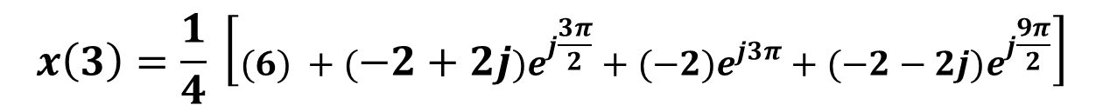
$$x\left(n\right)=\frac{1}{4} \left[(6) +(−2+2j)e^{j\frac{πn}{2}}+(−2)e^{jπn}+(−2−2j)e^{j\frac{3πn}{2}}\right] (1)$$
$X(k) =[6, −2+2j, −2, −2−2j$]
X(0) = 6
X(3) = -2-2j
X(1) = -2+2j
X(2) = -2
STEP:-2: Put n = 3 in equation (1)
$$x\left(3\right)=\frac{1}{4} \left[(6) +(−2+2j)e^{j\frac{π∗3}{2}}+(−2)e^{jπ∗3}+(−2−2j)e^{j\frac{3π∗3}{2}}\right]$$
$$x\left(3\right)=\frac{1}{4} \left[(6) +(−2+2j)e^{j\frac{3π}{2}}+(−2)e^{j3π}+(−2−2j)e^{j\frac{9π}{2}}\right]$$
$$x\left(3\right)=\frac{1}{4} \left[6+(−2+2j)(−j)+(−2)(cos3π+j sin3π)+(−2−2j)(cos\frac{9π}{2}+jsin\frac{9π}{2})\right]$$
$$x\left(3\right)=\frac{1}{4} \left[6+2j+2+\left(−2\right)\left(−1\right)+\left(−2−2j\right)\left(j\right)]=\frac{1}{4}\left[6+2j+2+2−2j+2\right]=\frac{1}{4}\left[12\right]=3\right]$$

Slide 15
$$x\left(n\right)=\left[x\left(0\right), x\left(1\right), x\left(2\right),x(3)\right]$$
$$x\left(n\right)=\left[0, 1, 2,3\right] Answer$$

Slide 16
IDFT SOLVE BY MATRIX METHOD

Slide 17
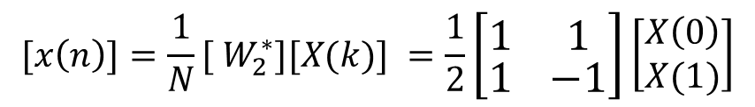
IDFT SOLVE BY MATRIX METHOD
$${DFT of 2−Point=W}_{2}=\left[\begin{matrix}W_{2}^{0} & W_{2}^{0} \\ W_{2}^{0} & W_{2}^{1}\end{matrix}\right]=\left[\begin{matrix}1 & 1 \\ 1 & −1\end{matrix}\right]$$
In Conjugate case only imaginary value is changed from –ve to +ve and +ve to –ve other matrix values are same
$$IDFTof 2−Point=Conjugate of DFT= {\frac{1}{2}W}_{2}^{∗} =\frac{1}{2}\left[\begin{matrix}1 & 1 \\ 1 & −1\end{matrix}\right]$$
$${[x\left(n\right)]=\frac{1}{N}[ W}_{2}^{∗}][X(k)] =\frac{1}{2}\left[\begin{matrix}1 & 1 \\ 1 & −1\end{matrix}\right]\left[\begin{aligned}X\left(0\right) \\ X(1)\end{aligned}\right]$$

Slide 18
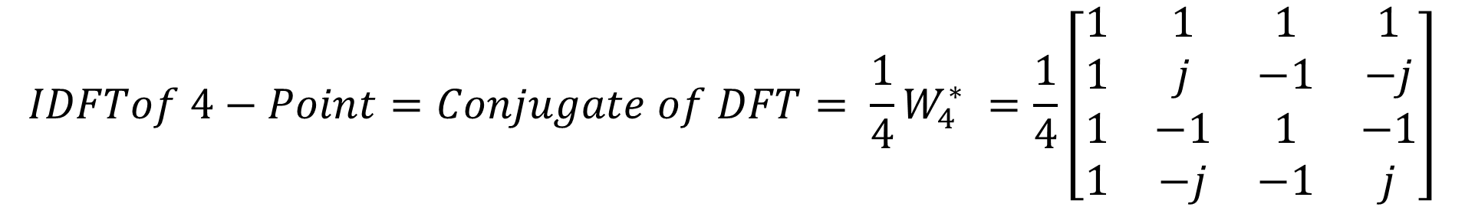
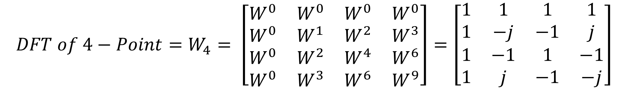
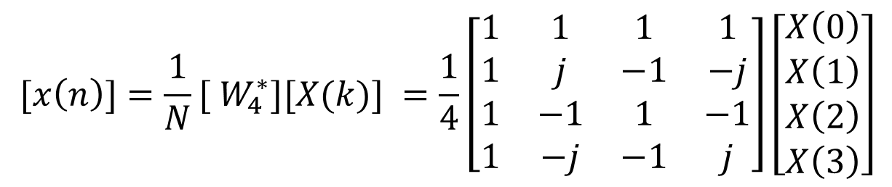
IDFT SOLVE BY MATRIX METHOD
$${DFT of 4−Point=W}_{4}= \left[\begin{matrix}W^{0} & W^{0} & W^{0} & W^{0} \\ W^{0} & W^{1} & W^{2} & W^{3} \\ W^{0} & W^{2} & W^{4} & W^{6} \\ W^{0} & W^{3} & W^{6} & W^{9}\end{matrix}\right]=\left[\begin{matrix}1 & 1 & 1 & 1 \\ 1 & −j & −1 & j \\ 1 & −1 & 1 & −1 \\ 1 & j & −1 & −j\end{matrix}\right]$$
$$IDFTof 4−Point=Conjugate of DFT= {\frac{1}{4}W}_{4}^{∗} =\frac{1}{4}\left[\begin{matrix}1 & 1 & 1 & 1 \\ 1 & j & −1 & −j \\ 1 & −1 & 1 & −1 \\ 1 & −j & −1 & j\end{matrix}\right]$$
In Conjugate case only imaginary value is changed from –ve to +ve and +ve to –ve other matrix values are same
$${[x\left(n\right)]=\frac{1}{N}[ W}_{4}^{∗}][X(k)] =\frac{1}{4}\left[\begin{matrix}1 & 1 & 1 & 1 \\ 1 & j & −1 & −j \\ 1 & −1 & 1 & −1 \\ 1 & −j & −1 & j\end{matrix}\right]\left[\begin{matrix}X\left(0\right) \\ X\left(1\right) \\ \begin{aligned}X\left(2\right) \\ X\left(3\right)\end{aligned}\end{matrix}\right]$$

Slide 19
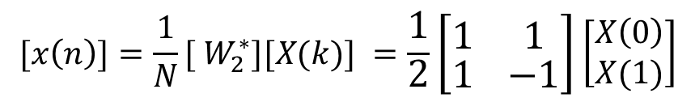

Example: Calculate the 2-point Inverse Discrete Fourier Transform (IDFT) of given sequence $X\left(k\right)=\{3, −3\}$
SOLUTION
$${[x\left(n\right)]=\frac{1}{N}[ W}_{2}^{∗}][X(k)] =\frac{1}{2}\left[\begin{matrix}1 & 1 \\ 1 & −1\end{matrix}\right]\left[\begin{aligned}X\left(0\right) \\ X(1)\end{aligned}\right]$$
$$\left[\begin{aligned}x\left(0\right) \\ x(1)\end{aligned}\right]=\frac{1}{2}\left[\begin{matrix}1 & 1 \\ 1 & −1\end{matrix}\right]\left[\begin{aligned}X\left(0\right) \\ X(1)\end{aligned}\right]=\frac{1}{2}\left[\begin{matrix}1 & 1 \\ 1 & −1\end{matrix}\right]\left[\begin{aligned}3 \\ −3\end{aligned}\right]=\frac{1}{2}\left[\begin{aligned}1∗3+1∗\left(−3\right) \\ 1∗3+1∗\left(3\right)\end{aligned}\right]=\frac{1}{2}\left[\begin{aligned}3−3 \\ 3+3\end{aligned}\right]=\frac{1}{2}\left[\begin{aligned}0 \\ 6\end{aligned}\right]=\left[\begin{aligned}0 \\ 3\end{aligned}\right]$$
$$x\left(n\right)=\left\{0, 3\right\} Answer$$

Slide 20
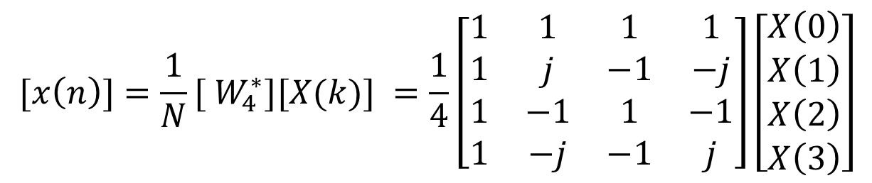
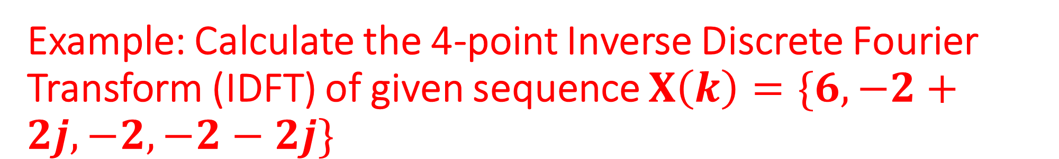
Example: Calculate the 4-point Inverse Discrete Fourier Transform (IDFT) of given sequence $X\left(k\right)=\{6, −2+2j, −2, −2−2j\}$
SOLUTION
$${[x\left(n\right)]=\frac{1}{N}[ W}_{4}^{∗}][X(k)] =\frac{1}{4}\left[\begin{matrix}1 & 1 & 1 & 1 \\ 1 & j & −1 & −j \\ 1 & −1 & 1 & −1 \\ 1 & −j & −1 & j\end{matrix}\right]\left[\begin{matrix}X\left(0\right) \\ X\left(1\right) \\ \begin{aligned}X\left(2\right) \\ X\left(3\right)\end{aligned}\end{matrix}\right]$$
$$\left[\begin{matrix}x\left(0\right) \\ x\left(1\right) \\ \begin{aligned}x\left(2\right) \\ x\left(3\right)\end{aligned}\end{matrix}\right]=\frac{1}{4}\left[\begin{matrix}1 & 1 & 1 & 1 \\ 1 & j & −1 & −j \\ 1 & −1 & 1 & −1 \\ 1 & −j & −1 & j\end{matrix}\right]\left[\begin{matrix}X\left(0\right) \\ X\left(1\right) \\ \begin{aligned}X\left(2\right) \\ X\left(3\right)\end{aligned}\end{matrix}\right]=\frac{1}{4}\left[\begin{matrix}1 & 1 & 1 & 1 \\ 1 & j & −1 & −j \\ 1 & −1 & 1 & −1 \\ 1 & −j & −1 & j\end{matrix}\right]\left[\begin{aligned}6 \\ −2+2j \\ −2 \\ −2−2j\end{aligned}\right]=\frac{1}{4}\left[\begin{aligned}1∗\left(6\right)+1 ∗\left(−2+2j\right)+1∗\left(−2\right)+1∗(−2−2j) \\ 1∗\left(6\right)+j ∗\left(−2+2j\right)−1∗\left(−2\right)−j∗(−2−2j) \\ 1∗\left(6\right)−1 ∗\left(−2+2j\right)+1∗\left(−2\right)−1∗(−2−2j) \\ 1∗\left(6\right)−j ∗\left(−2+2j\right)−1∗\left(−2\right)+j∗(−2−2j)\end{aligned}\right]=\left[\begin{aligned}0 \\ 1 \\ 2 \\ 3\end{aligned}\right]$$
$$x\left(n\right)=\left\{0,1,2,3\right\} Answer$$

